Slide 1
Hypothesis Testing

Slide 2
Hypothesis Testing
Hypothesis testing was introduced by Ronald Fisher, Jerzy Neyman, Karl Pearson and Egon Pearson.
Generally the term Hypothesis means uncertainity in solution.
It is nothing but deciding whether hypothesis is true or false.
Hypothesis testing is a statistical method that is used in making statistical decisions using experimental data.
Hypothesis Testing is basically an assumption that we make about the population parameter.

Slide 3
Types Of Hypothesis
Hypothesis
Null Hypothesis
Alternative Hypothesis

Slide 4
Null Hypothesis
Understanding population parameter as believing it is true,whatever it is claimed by others untill and unless it has no contrary.
Null Hypothesis is represented as below
H₀: μ= μ₀
where,
H₀ = the null hypothesis
μ = the mean of population and
μ₀ = the mean of population(which we don’t know)

Slide 5
Alternative Hypothesis
Alternative hypothesis is contrary of null hypothesis.
Hypothesis is represented as below
H_{a}: μ> μ₀
where,
H_{a} = the alternative hypothesis
μ = the mean of population and
μ₀ = the mean of population(which we don’t know).
Every Null Hypothesis has an associated Alternative Hypothesis, denoted H_{a}
This is always stated as an inequality either ≠, >, or <.

Slide 6
Critical Values/Level Of Significance
In hypothesis testing, a critical value is a point on the test distribution that is compared to the test statistic to determine whether to reject the null hypothesis.
If the absolute value of your test statistic is greater than the critical value, you can declare statistical significance and reject the null hypothesis.

Slide 7
Testing Types
There are mainly two things to consider in hypothesis testing,they are
1.One Tail Test
2.Two Tail Test
If H_{a}: μ₀ > μ →1Tailed/right side
If H_{a}: μ₀ < μ →1Tailed/left side
If H_{a}: μ₀ != μ→Two Tailed/both sides

Slide 8
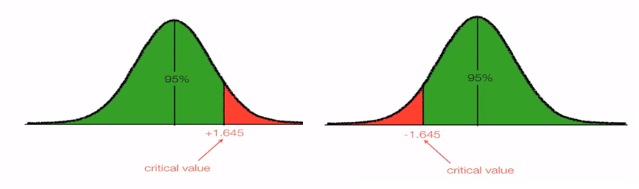
One Tail Test

Slide 9
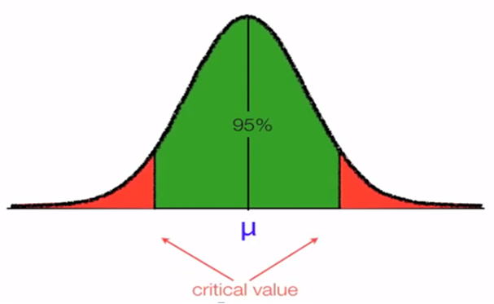
Two Tail Test

Slide 10
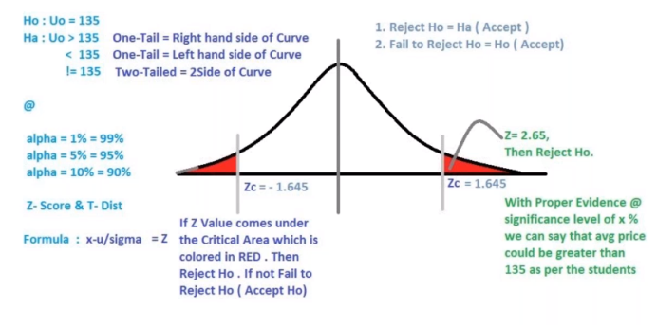

Slide 11
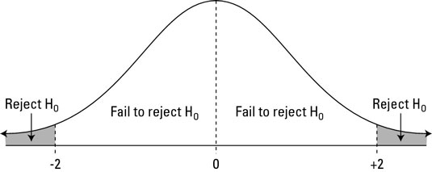
Critical Values/Level Of Significance
Critical Value

Slide 12
Examples
Public Opinion About President On May 16, 1994, Newsweek reported the results of a public opinion poll that asked: “From everything you know about Bill Clinton, does he have the honesty and integrity you expect in a president?”
Poll surveyed 518 adults and 233, or 0.45 of them (clearly less than half), answered yes.
Could Clinton’s adversaries conclude from this that only a minority (less than half) of the population of Americans thought Clinton had the honesty and integrity to be president?

Slide 13
Steps to be followed:
Step 1: Determine the null and alternative hypotheses.
Null hypothesis: There is no clear winning opinion on this issue; the proportions who would answer yes or no are each 0.50.
Alternative hypothesis: Fewer than 0.50, or 50%, of the population would answer yes to this question. The majority do not think Clinton has the honesty and integrity to be president.
Step 2: Collect and summarize data into a test statistic. Sample proportion is: 233/518 = 0.45.
The standard deviation: ((0.50) × (1 – 0.50))/518= 0.022.
Test statistic: z = (0.45 – 0.50)/0.022 = –2.27

Slide 14
Step 3: Determine the p-value.
Recall the alternative hypothesis was one-sided.
p-value = proportion of bell-shaped curve below –2.27 Exact p-value = 0.0116.
Step 4:Make a decision.
The p-value of 0.0116 is less than 0.05, so we conclude that the proportion of American adults in 1994 who believed Bill Clinton had the honesty and integrity they expected in a president was significantly less than a majority.

Slide 15
Summary
Hypothesis means uncertainity in solution.
Null hypothesis is Understanding population parameter as believing it is true,whatever it is claimed by others untill and unless it has no contrary where as Alternative hypothesis is fully opposite to it.
There are only two main scenarios in Hypothesis testing.
Reject Null Hypothesis
Failed to reject Null Hypothesis

Slide 16
Thank you

